Slide 1
Secure Electronic Transaction

Slide 2
Learning objectives
Introduction to SET
Functionalities of SET
Requirements for SET
SET transactions
Dual signature

Slide 3
Secure Electronic Transaction
An application layer security mechanism, consisting of a set of protocols
Protect credit card transaction on the internet
It uses different encryption and hashing techniques to secure payments over the internet done through credit cards.
Master card, Visa, IBM, Microsoft, Netscape, Cyber cash etc.

Slide 4
Functionalities of SET
Confidentiality of information
Integrity of data
Authentication
Cardholder account authentication
Merchant authentication

Slide 5
Confidentiality
Confidentiality refers to preventing unintended people from reading the message being transferred.
SET provides credit card number can be seen by issuing bank only but never seen by seller or merchant
SET implements confidentiality by using encryption techniques. Traditionally DES is used for encryption purposes.

Slide 6
Integrity
SET doesn’t allow message modification with the help of signatures. It guarantees that the message contents are not altered.
Messages are protected against unauthorized modification using RSA digital signatures with SHA-1

Slide 7
Authentication
Merchant Authentication – To prevent theft, SET allows customers to check previous relationships between merchants and financial institutions.
Customer / Cardholder Authentication – SET checks if the use of a credit card is done by an authorized user or not.
SET uses x.509v3 digital certificates with RSA signatures for verification

Slide 8
Requirements in SET
It has to provide mutual authentication i.e., customer authentication and merchant authentication
It has to keep payment information and order information confidential using appropriate encryptions
Resistive against message modifications
It also needs to provide interoperability and make use of the best security mechanisms

Slide 9
Participants in SET
Cardholder/Customer: The authorized user of payment card
E-commerce merchant: Seller
Card issuer: A financial organization(bank) that issue the payment card
Acquirer: A financial organization that processes payment authorization and facilitates electronic funds transfer to the merchant's account
Payment Gateway: Interface between card payment networks and secure electronic transactions
Certificate Authority: Trusted organization that provides public key digital certificates

Slide 10
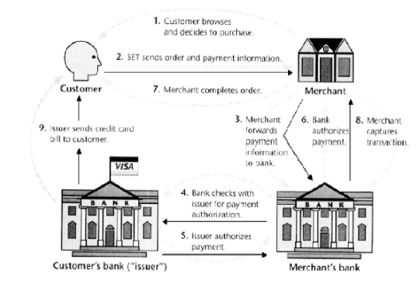

Slide 11
SET transactions
The customer sends order and payment information to the merchant
The merchant requests payment authorization from the payment gateway prior to shipment
The merchant confirms order to the customer
The merchant provides the services to the customer
The merchant requests payment from the payment gateway

Slide 12
Dual signature
The purpose of the dual signature is to link two messages that are intended for two different recipients from a single sender
Recipients:
Order Information (OI) for merchant Payment Information (PI) for bank
Sender:
Customer

Slide 13
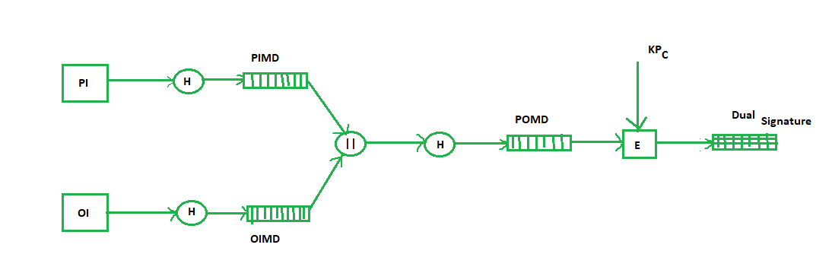

Slide 14
THANK YOU

